Slide 1
Quantum LDPC Decoding
Aidan Westphal
James Bialas
Yi Hung Lim

Slide 2
Motivation

Slide 3
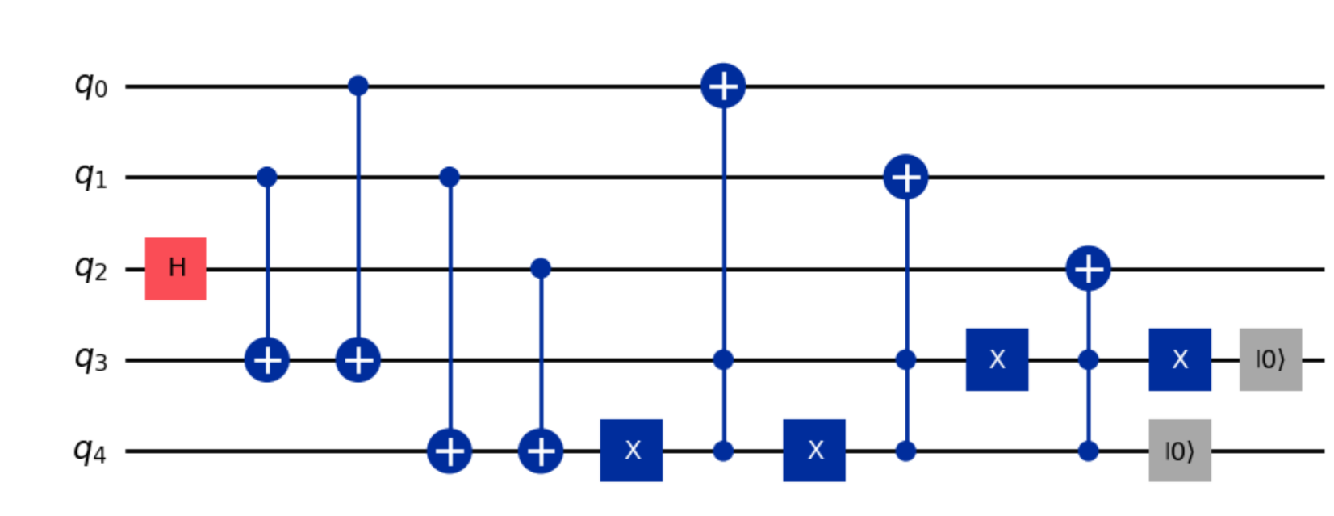
Normal Error Correction
Works for small number of Qubits
Can be used for both Bit and Phase flip
Inefficient for larger applications
Fewer logical Qubits available

Slide 4
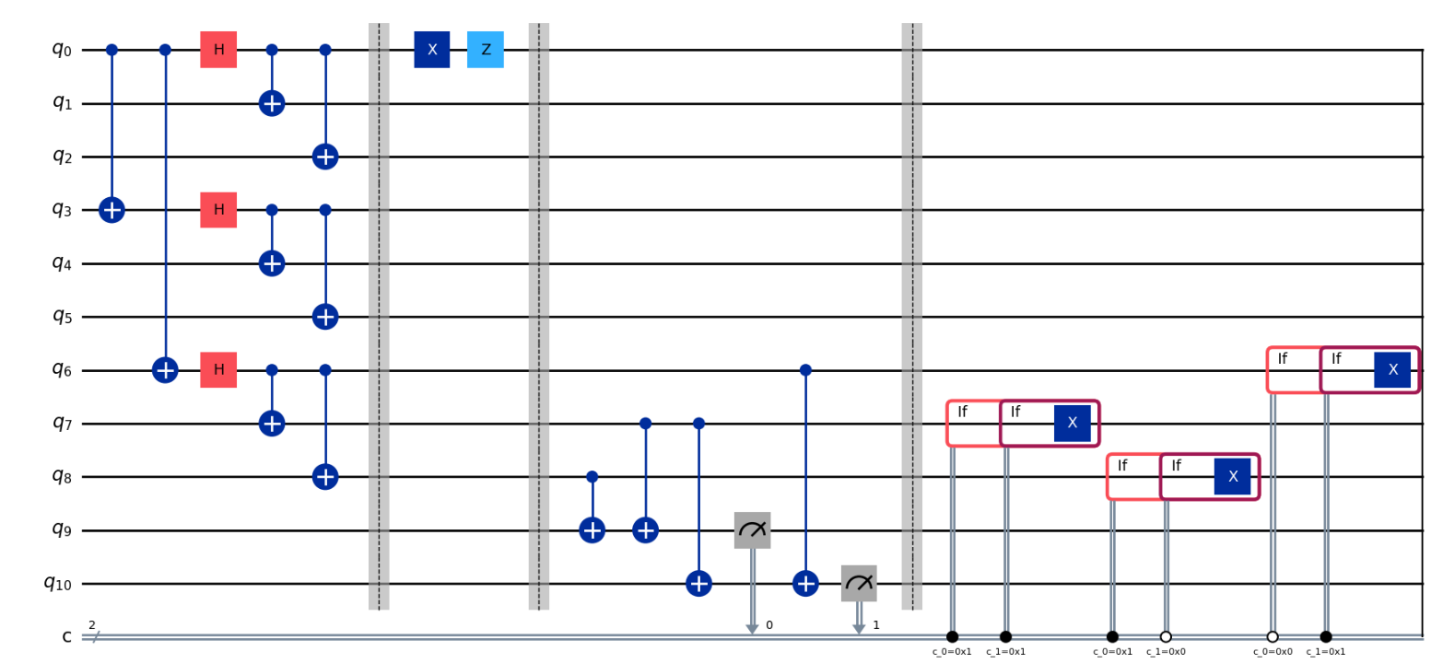
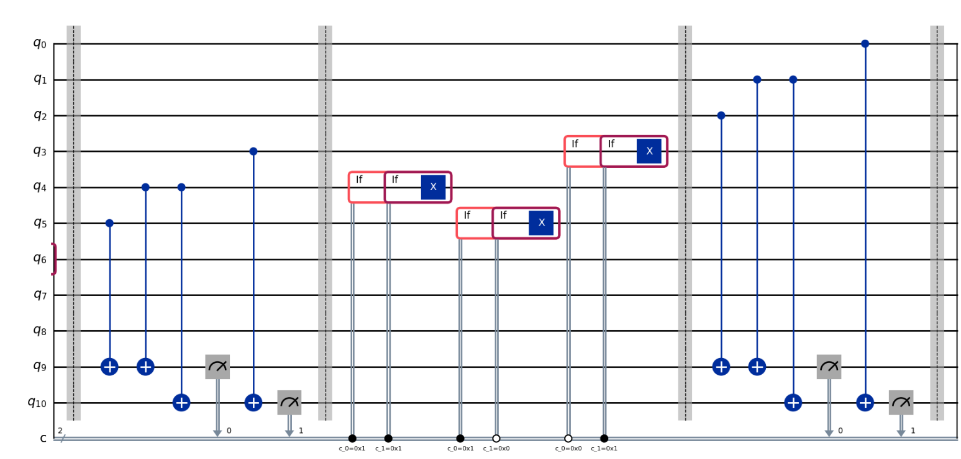
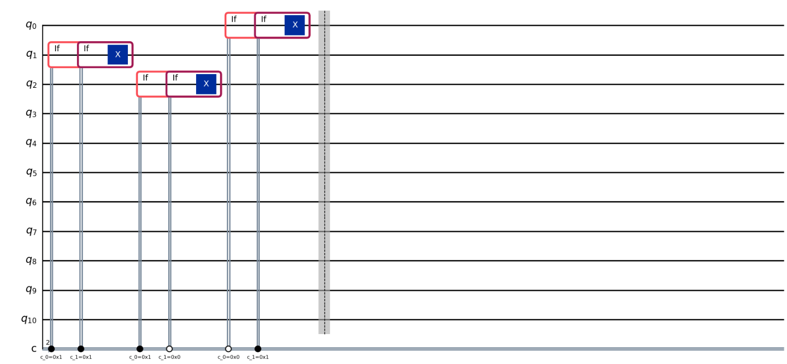
Quantum LDPC Error Correction
Works for larger number of Qubits
Can be used for both Bit and Phase flip
Efficient for larger applications
More logical Qubits available

Slide 5
Methodology
Notes:
So now I’m going to briefly go over some of the challenges that we encountered while researching and implementing Quantum LDPC codes. This should be useful in the future for people who will work on quantum error correction.

Slide 6
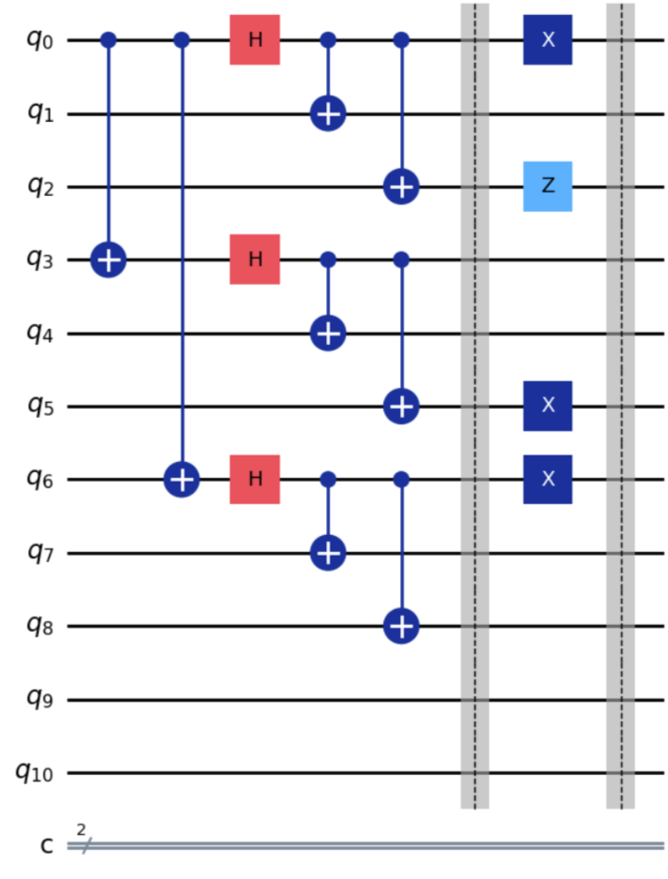
Shor Code
Shor’s Code uses 9 qubits
In this example, there is induced error on 4 qubits
We need to use quantum bits 9 and 10 to correct for errors
There needs to be two iterations of error correction
Bit Flip
Phase flip
These two types of errors can be corrected separately using BP and OSD

Slide 7
Results, Milestones, and Deliverables
QisKit!

Slide 8
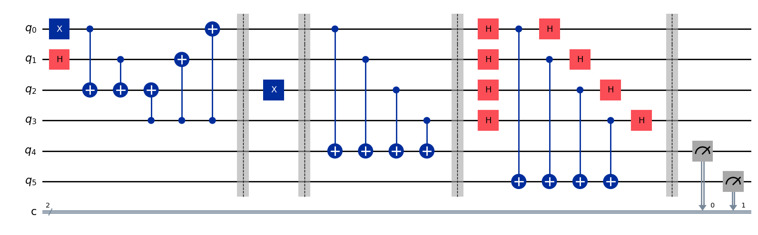
Phase and Bit Flip Syndromes
We first needed to show how to measure parity values.
The following is a [4,2,2] code with H_{x} = H_{z} = [1 1 1 1] for parity check.
Input state is |01>
Bit flip error applied to q₂.
We measured in bit and phase domains.

Slide 9
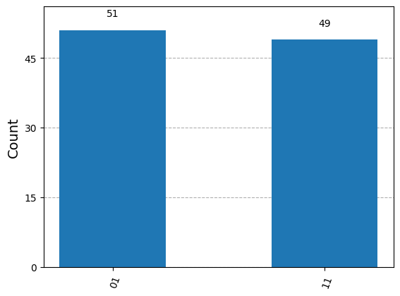
Phase and Bit Flip Syndrome
In the histogram, the left bit is c1 (phase) and the right bit is c0 (bit).
Bit parity is 1, phase error is toss-up.
This is expected behavior! A [4 2 2] code is only able to detect a singular error.
We realized we needed to pick a larger code for our project.
Shor Code!

Slide 10
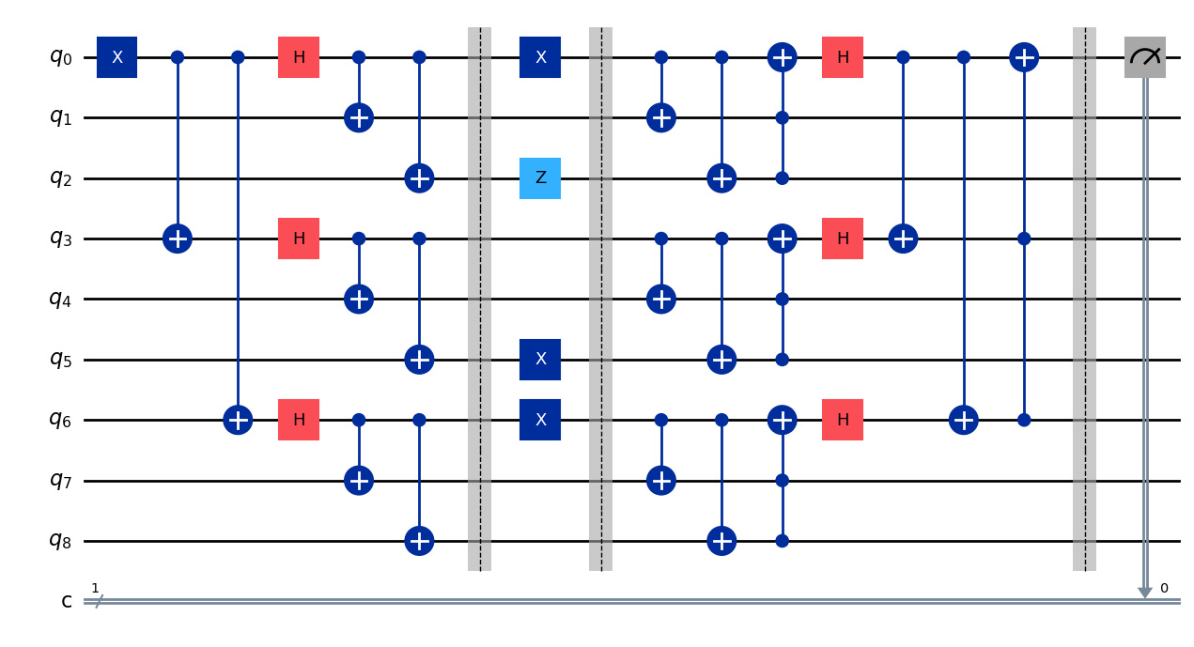
Shor Code Control Solution
Encoding Shor Code with a state |1> in q₀.
Middle segment applies arbitrary error.
Bit flip errors to q₀, q₅, and q₆.
Phase flip error to q₂.
Standard decoding of Shor Code.

Slide 11
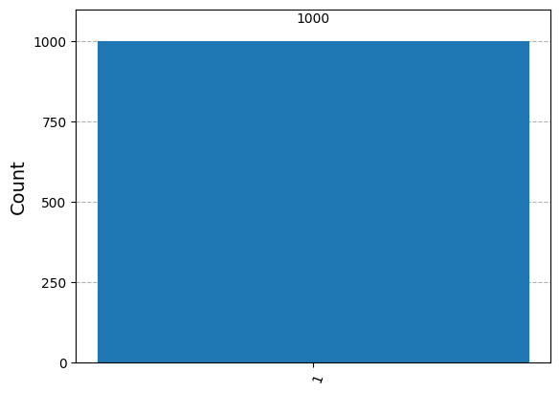
Shor Code Control Measurements

Slide 12
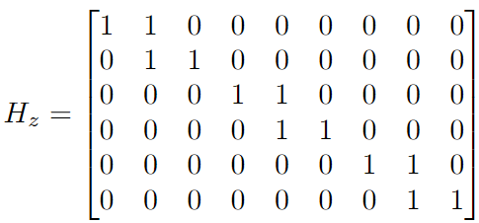

Shor Code Parity Check Matrices

Slide 13
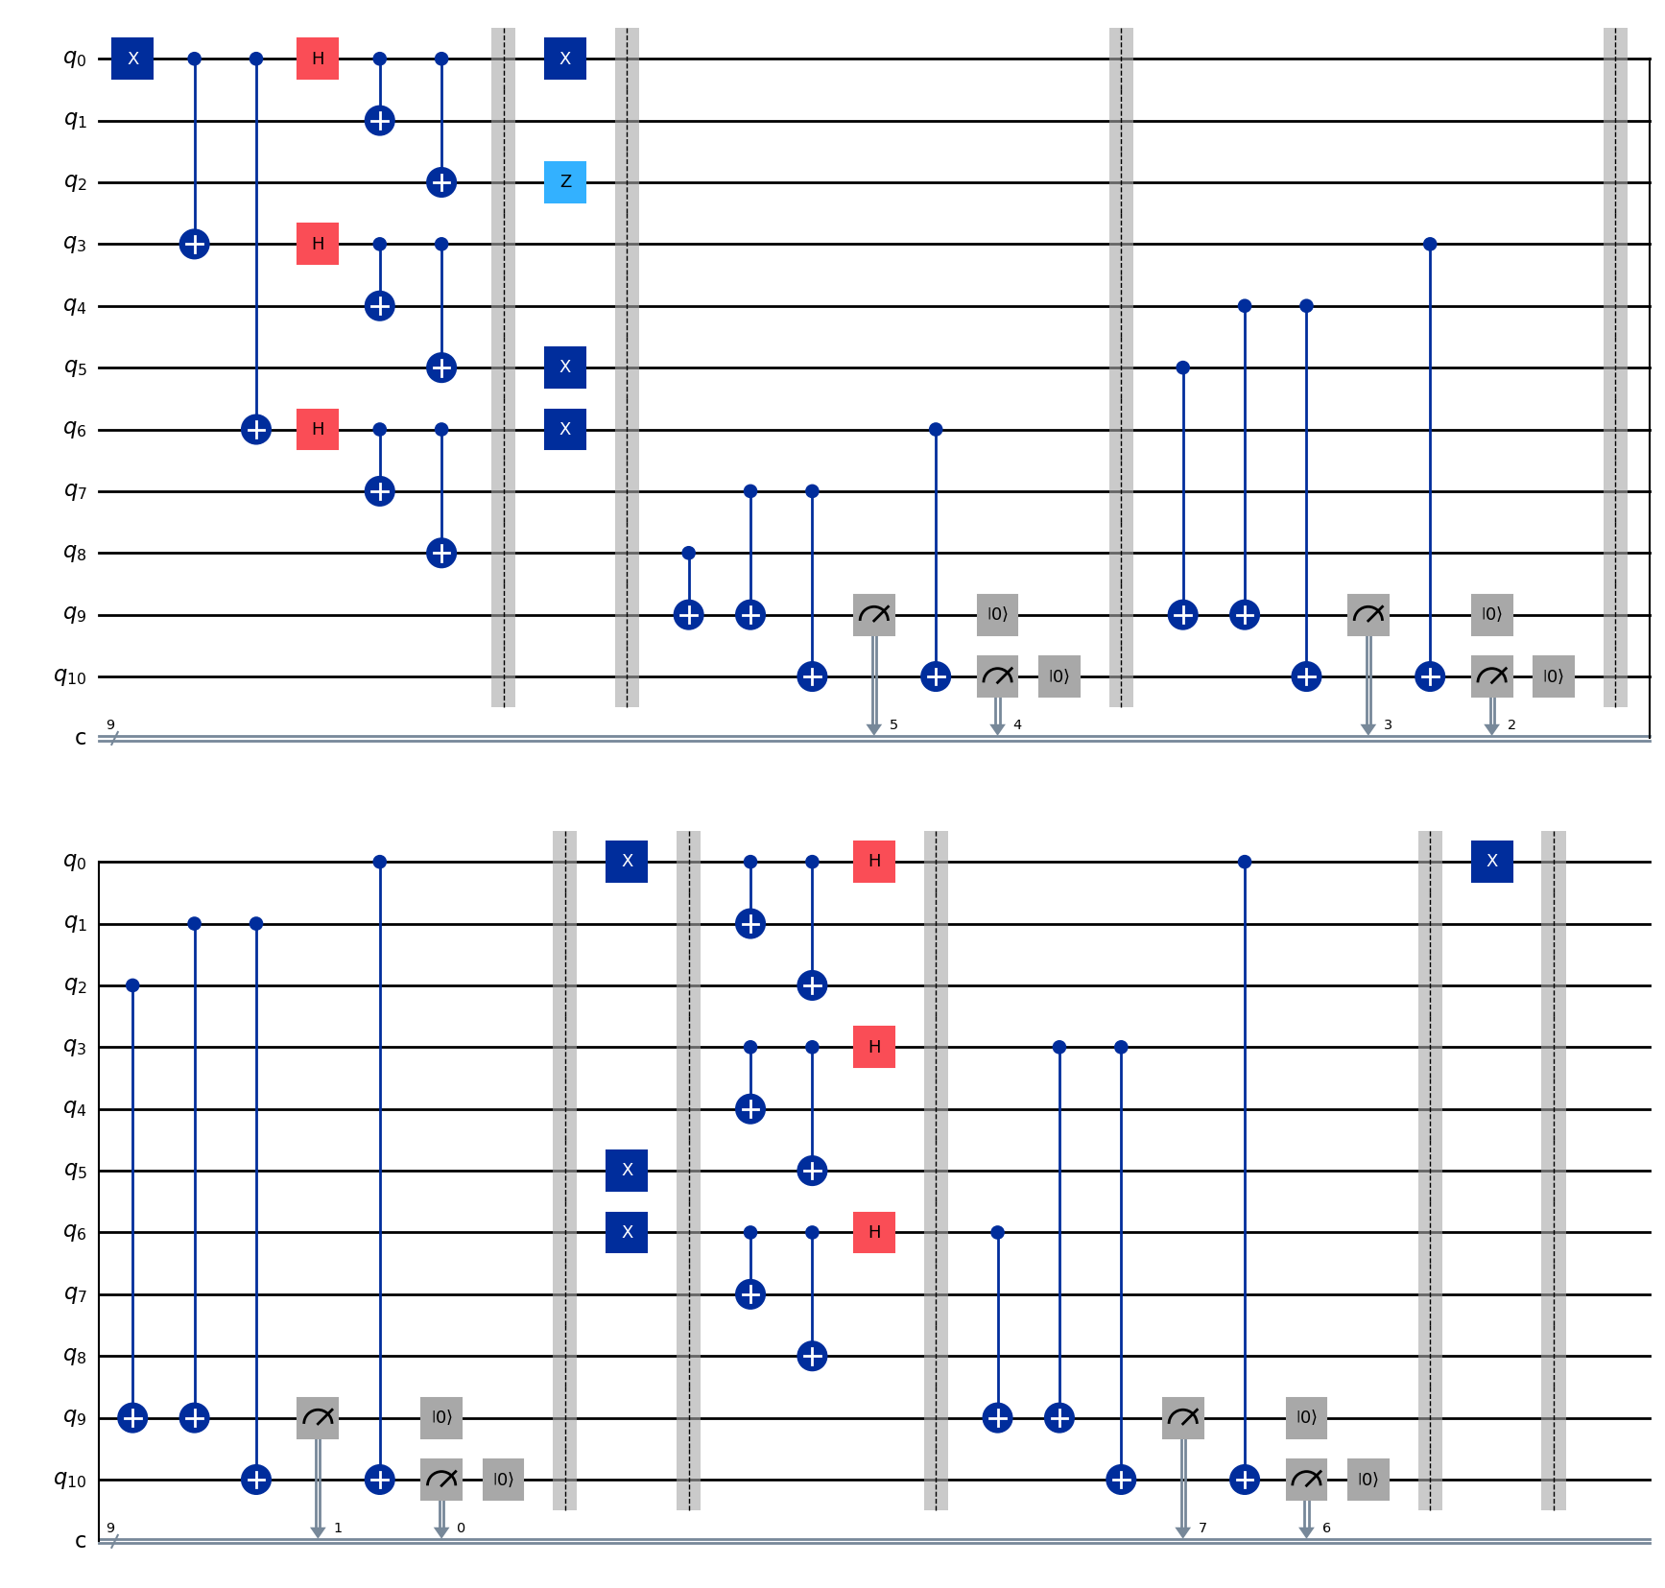
Shor Code Parity Measuring
The first three barriers are measuring the bit parities in each triplet.
BP Solution to bit flip error are three X gates.
We then convert to X basis and measure the phase parity.
BP Solution to phase flip error flips the phase of the first triplet.

Slide 14
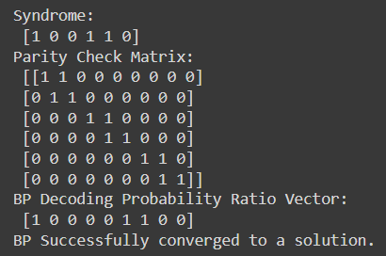
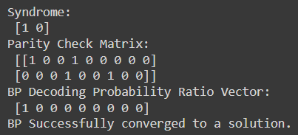
Belief Propagation
We used the LDPC Python Library to run Belief Propagation.
There are no trapping sets or cycles in Shor Code, therefore BP converged each time.
The vectors return specify which qubits to flip
E.g. the first one flipped qubits 0, 5, and 6.
These flips are seen in the previous slide.

Slide 15
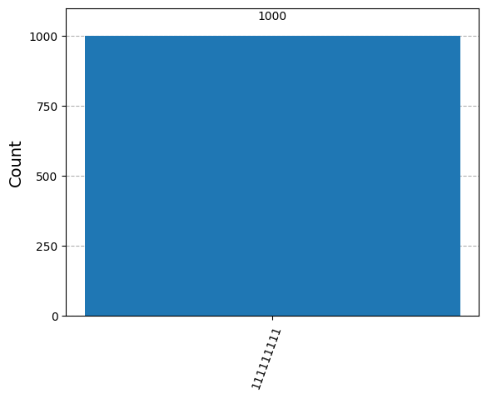
Measuring Corrected Shor Code
Since we had multiple classical registers, we copied the result of q₀ into all registers for our final output.
The final output was consistent with the control.

Slide 16
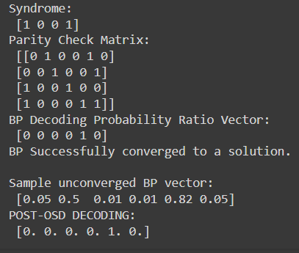
OSD Example
Chose an arbitrary H matrix and syndrome.
Created a sample BP output vector with non-converging probabilities.
Ran OSD on this vector to get the same output.

Slide 17
Challenges
Notes:
So now I’m going to briefly go over some of the challenges that we encountered while researching and implementing Quantum LDPC codes.
This should be useful in the future for people who will work on quantum error correction.

Slide 18
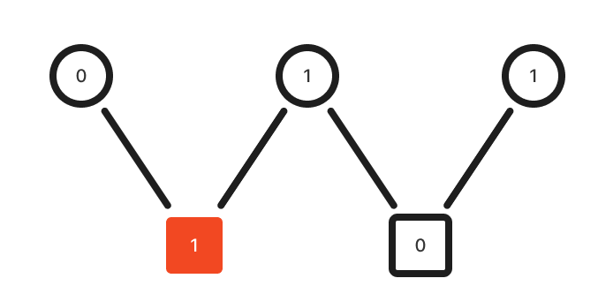
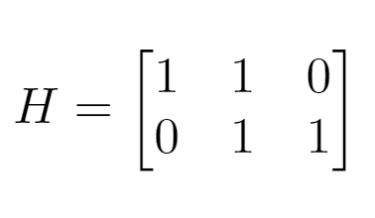

Quantum LDPC Concepts
There were Quantum LDPC Concepts that were not as intuitive for first time researchers, hence we summarize some of them here.
e = H⁻¹s is the equation for error where e = error, H = parity check matrix, s = syndrome
y = y + e where the error changes a state y
H(y + e) which represents the parity of the state, H(y + e) = Hy + He = He
s = He syndrome which is the set of parities returned from the H matrix
Notes:
So here are some quantum LDPC concepts. Since many of them are not as intuitive at first, I tried so summarize them in this slide so it is more understandable.
First we have e = Hs, which represents the equation for error and is calculated using a parity matrix and a syndrome.
Then, we have the error which is added to a state y.
We also have H times y + e which represents the parity of the state
Then we have syndrome which is the set of parities returned from the H matrix.

Slide 19
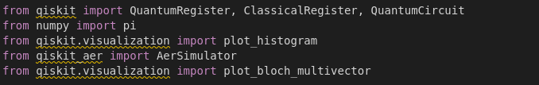
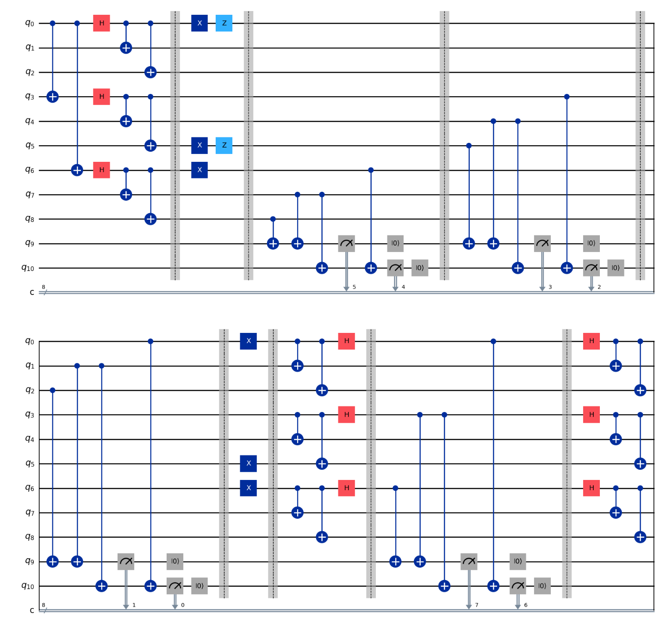
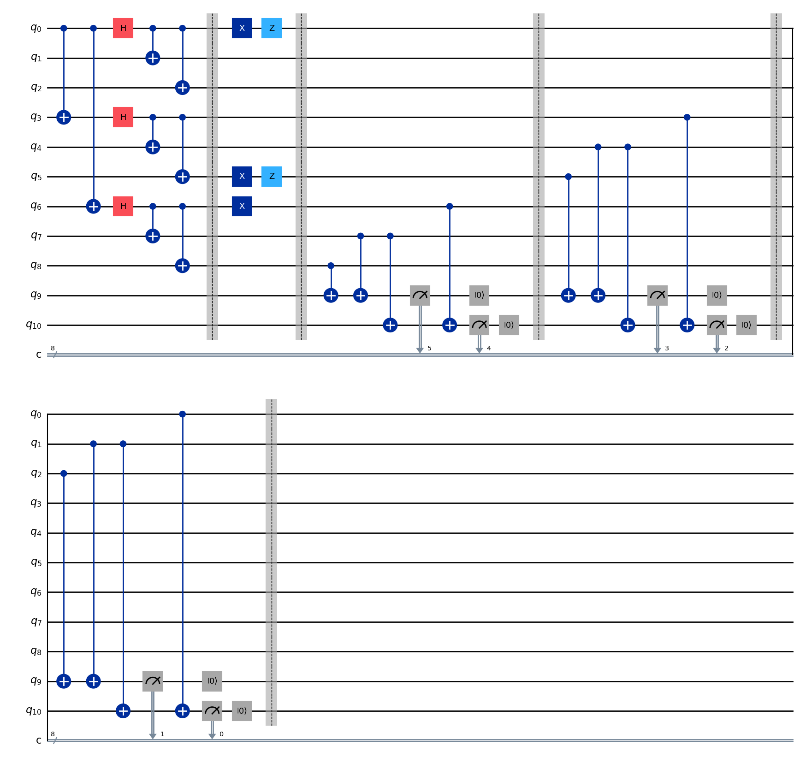
Using Qiskit
Using Qiskit, we have to research tools such as QuantumRegister, AerSimulator, plot_block_multivector etc…
We also had to measure bit flip and phase flip parity using our quantum circuits which is shown below.
We then had to verify the belief propagation output to determine whether we should continue with OSD.
Notes:
For the qiskit implementation of Quantum LDPC codes, we used many tools from the library such as Quantum Register, AerSimulator, plot_block_multivector etc…
We also had to measure bit flip and phase flip using our implementation of the quantum circuits.
We then had to verify the belief propagation output in code, then check to determine if we should return the answer or continue with ordered statistics decoding.

Slide 20
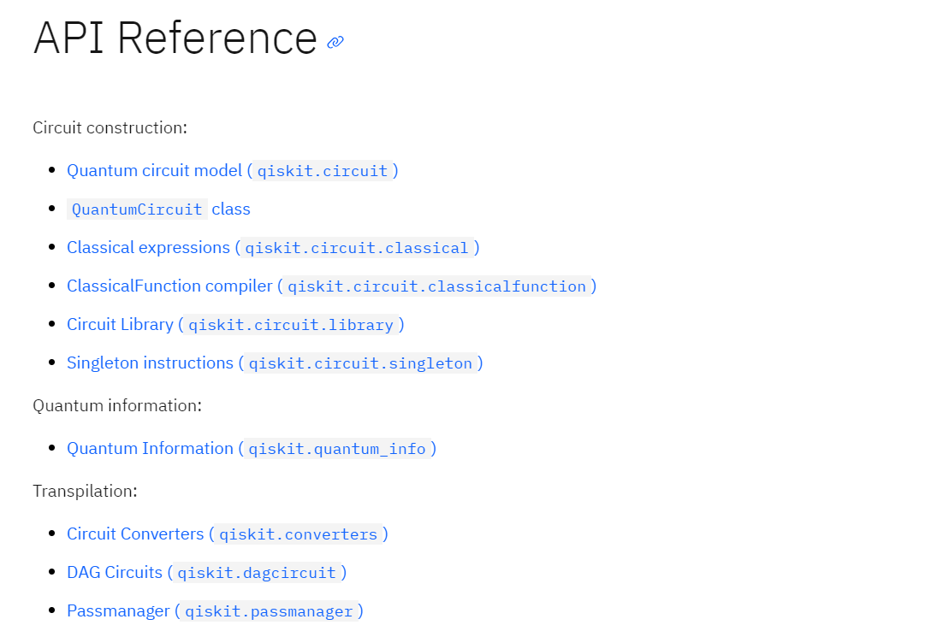
Using Qiskit
Challenges with using Qiskit:
Qiskit documentation was confusing different parts
There were many issues with version 1.0 vs previous versions
It was hard to navigate the Qiskit documentation
Notes:
Aside from the implementation, qiskit can be confusing, there were many issues with version 1.0 vs previous versions. It was also hard to navigate the qiskit documentation.

Slide 21
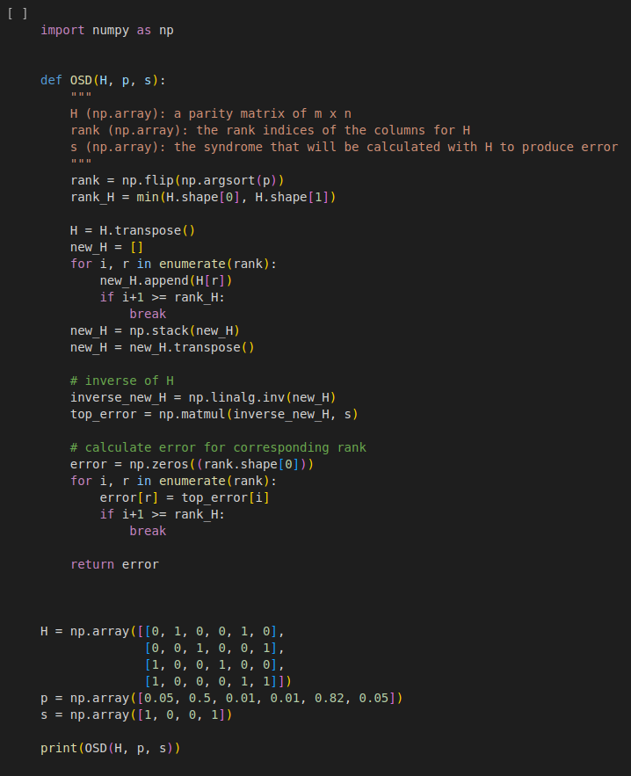
Ordered Statistics Decoding
Ordered statistics decoding is a classical algorithm that can be implemented with numpy and python, hence we try implemented it as a function as shown below. One of the challenges was to figure out which numpy operations to perform to achieve a particular step, such as finding the highest probability columns
We also ran into issues ensuring our subset of columns was invertible. Furthermore, if we have a 4x4 matrix that isn’t full rank, we can never invert it for a solution.
Notes:
We had to implement the ordered statistics decoding algorithm from scratch which is a classical algorithm using numpy and python.
One of the challenges was to figure out which numpy operations to perform to achieve a particular step such as finding the highest probability columns and rearranging them for the square matrix.
We use argsort to find the rank of the columns, then we loop over the columns to find the n highest probability column and put it in new_H,
We then take its inverse and use it to calculate the error for its corresponding indices, the rest of the errors filled in as zero since they have lower probability.
While we were writing the implementation, OSD sometimes didn’t work and we had issues with picking a full rank square matrix.

Slide 22
References

Slide 23
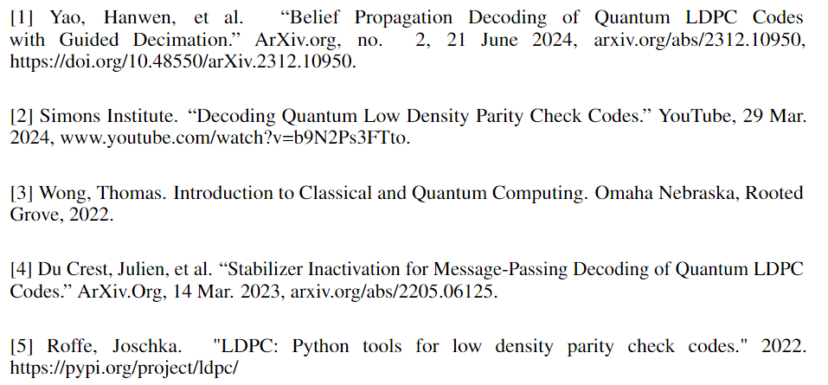
Reference List

